Slide 1
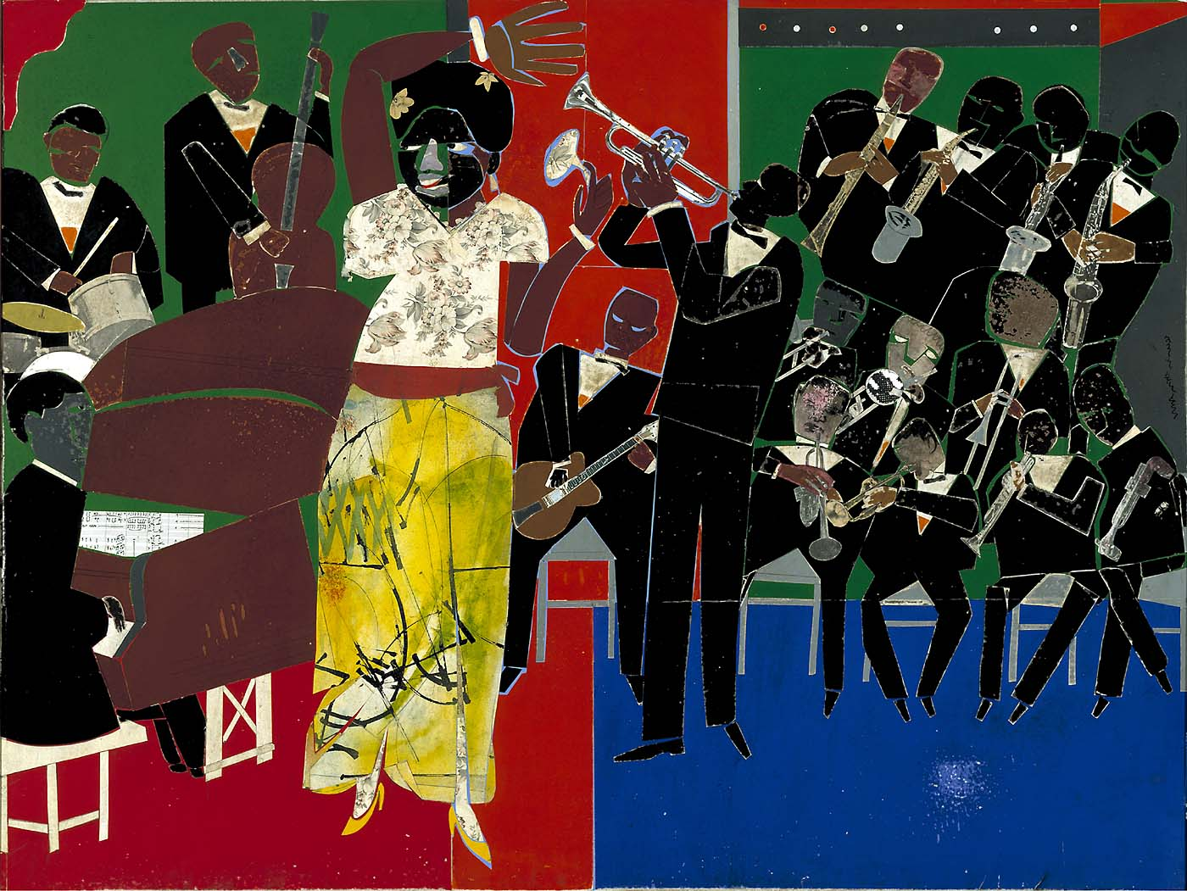
Empress of the Blues, 1974
Notes:
Where can you see evidence of a room?
How does the lighting feel? Do the saturated, vivid solid colors make the painting dark?
It’s tricky to see, but where is the perspective? How do the band members add to the perspective?

Slide 2
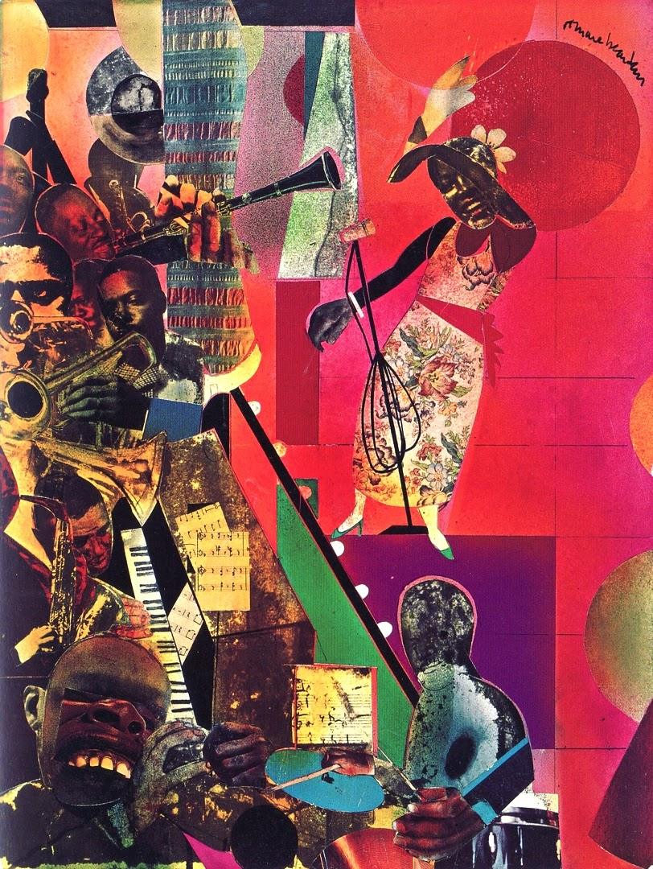
The Blues, 1978
Notes:
How does color make this painting feel?
Does the singer look happy?
Where did Bearden make a shape or figure and cut it out of something surprising?

Slide 3
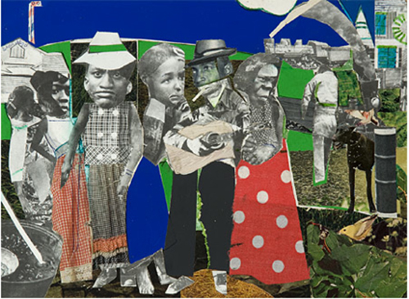
“Watching the Good Trains Go By” (1969)
Notes:
Is this day or night?
Tell me something about one of the figures.

Slide 4
Watching the Good Trains Go By, 1964
Notes:
This is an earlier version, all collage. How does the muted color alter the mood?

Slide 6
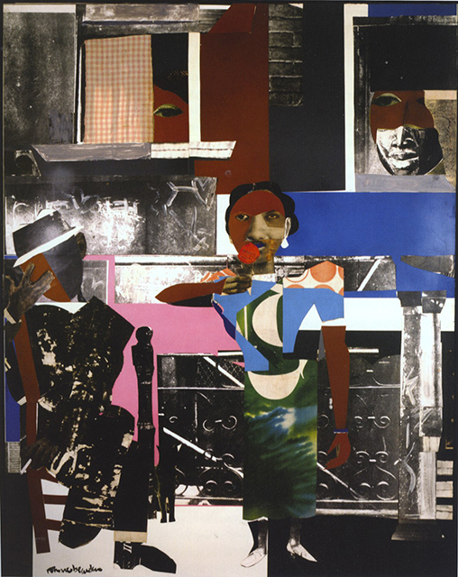
Summertime, 1967
Notes:
What does the use of black and white mixed with color do?
Can you see the African mask?

