Slide 1
https://www.sfmoma.org/watch/ellsworth-kelly-explains-abstraction/
Notes:
A great short clip of Kelly in his studio. Can be omtted.

Slide 2
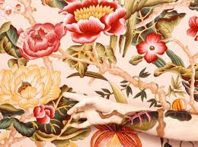
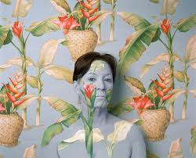
Figurative Abstract Portraits
http://www.artnet.com/artists/cecilia-paredes/

Slide 3
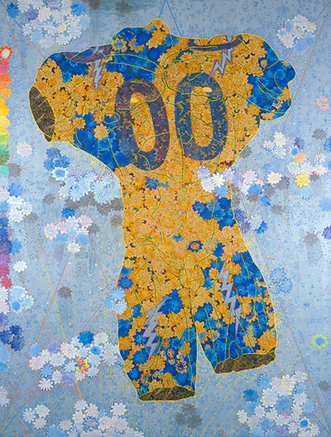
Figurative Abstraction
The Nature of How We See, Chie Fueki, 2005
Notes:
Feminine and masculine roles, sexism, domesticity, textile art. How is this figural? How does it refer to domesticity and women's roles?

Slide 4
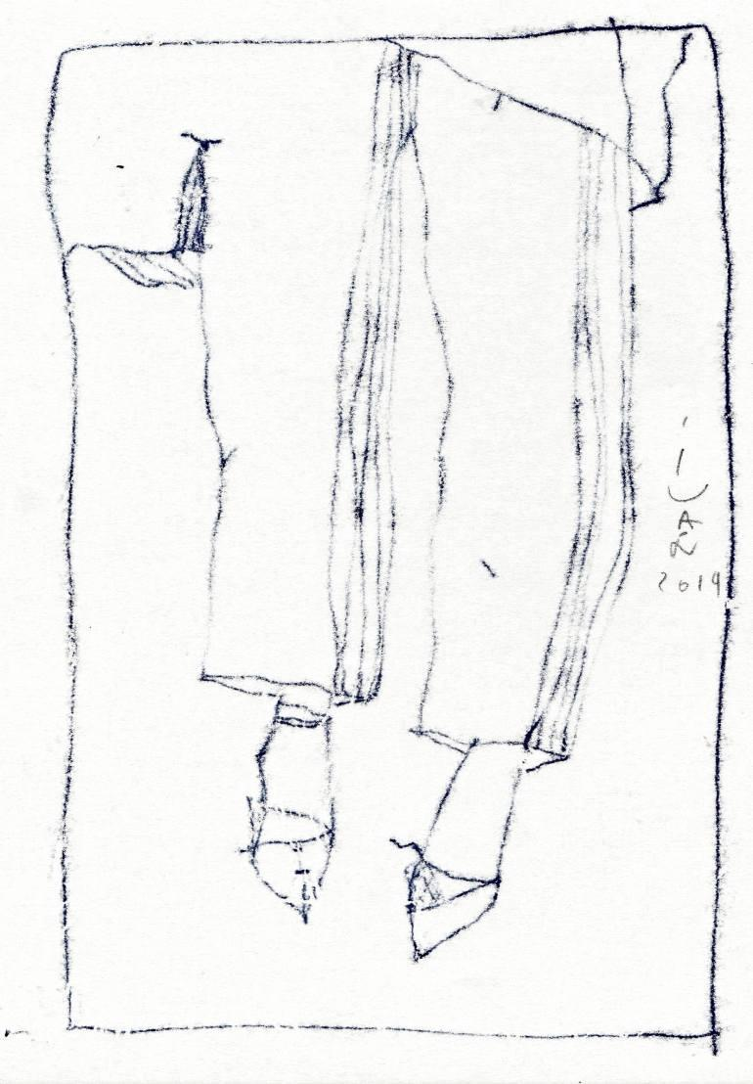
Ivan Pchelintsev
Ivan Pchelintsev
New Shoes
Figurtive Abstraction
Notes:
Abstract does not always mean gestural or geometric. How has the artist abstracted this figure?

Slide 5
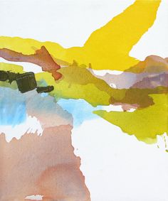
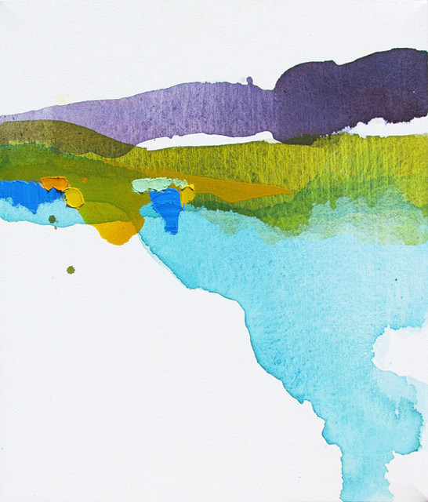
Lauren Adams, recent work
Landscape Abstraction
Notes:
How does the class feel about the white space? The purple/yellow? Does this look easy?

Slide 6
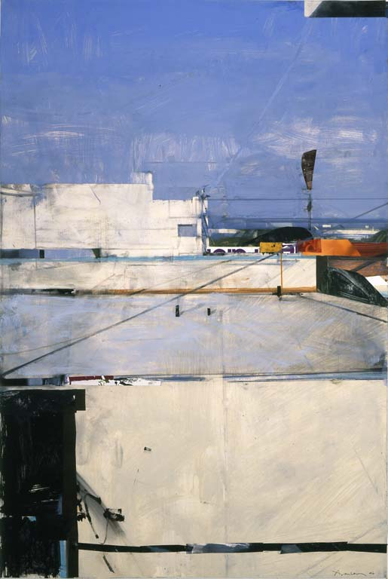
Santa Monica Rooftops, Ben AronsonssA
Landscape Abstraction
Notes:
This is from life but composed into an arrangement of abstract shapes and light. How is warm and cool used in this work?

Slide 7
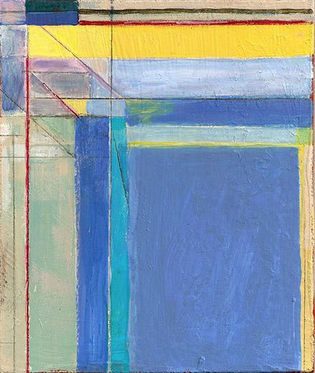
Ocean Park Series Richard Diebenkorn
Landscape Abstraction
Notes:
This landscape abstraction seems to fit a few other categories...any guess as to which one?

Slide 8
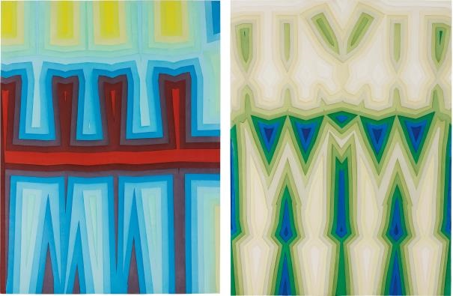
Tauba Auerbach
Two Works: (i) Fold / Slice Topo I;
(ii) Fold /..., 2011 113 x 188.2 cm.
Geometric
Abstraction
Notes:
Geometric Abstraction with a lot of work in _____________?
The work with color and value in these activates the composition of each work. More or less than the rhythm and other elements?

Slide 9
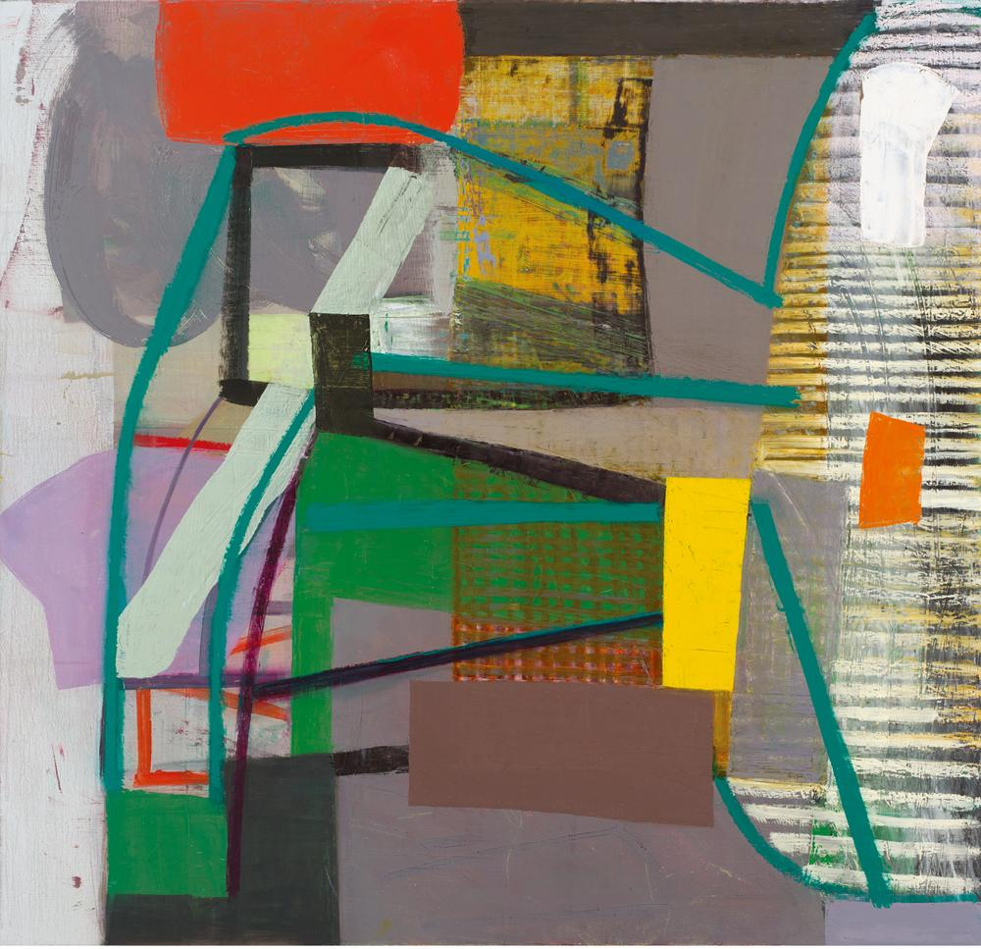
Amy Sillman, Untitled, 2013
Geometric Abstraction
Notes:
Are the grays warm or cool?

Slide 10
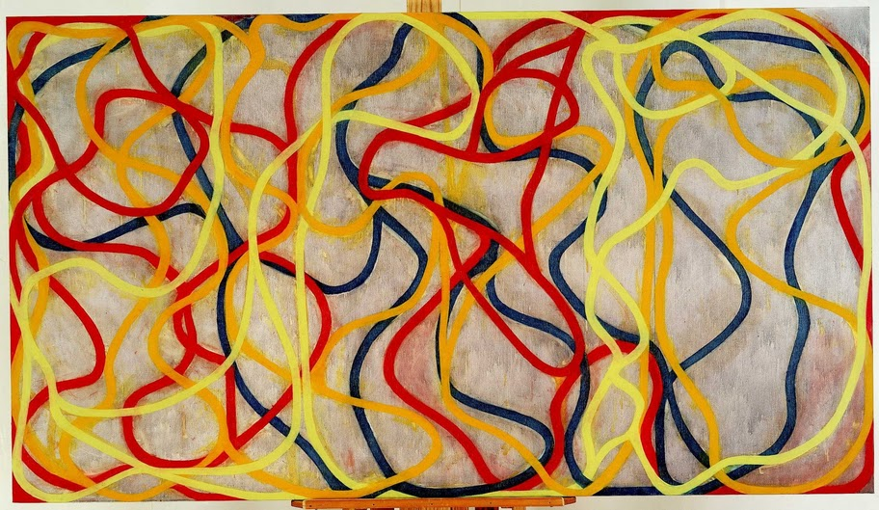
Brice Marden
Chinese Dancing, 1994-96. Oil on canvas, 60 x 108.
Calligigraphic Abstraction
Notes:
How is the depth here achieved? Moreso by the intense lines or the hazy, cool background?

Slide 11
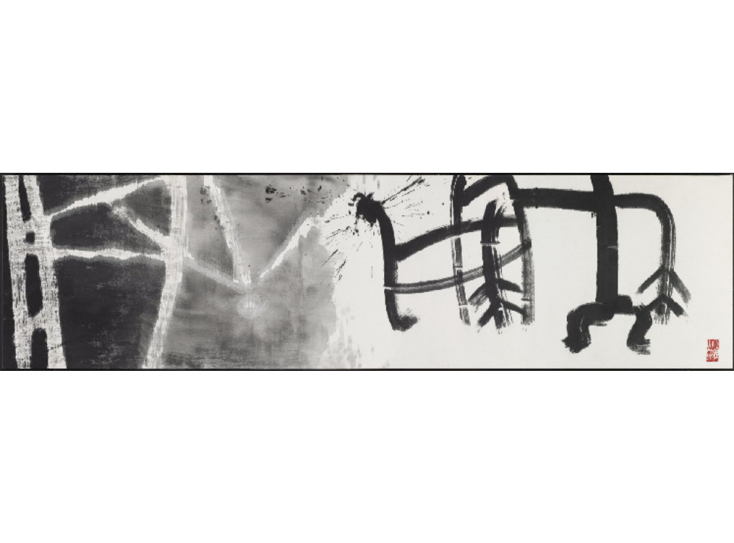
Caligraphic Abstraction
Son Man-jine
Use of the Useless (Quotation From Zhuangzi ca. 300 B.C.), 1999 Ink on cloth 31 1/2 × 110 1/5 in 80 × 280 cm

Slide 12
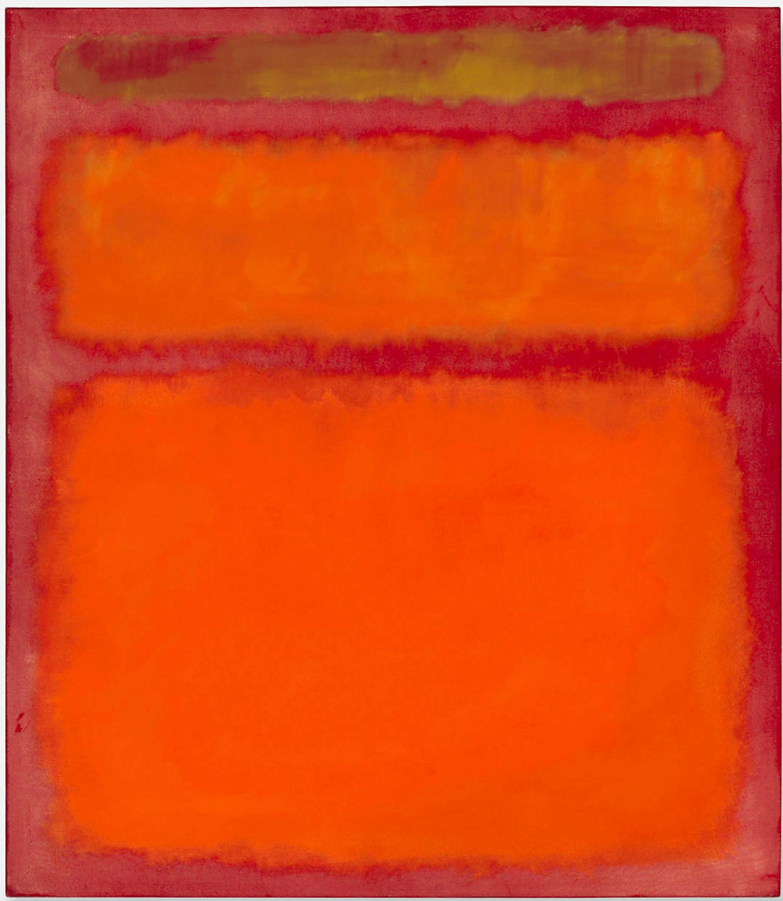
Mark Rothko
Orange, Red, and Yellow, 1961
Colorfield Abstraction
Notes:
Is any part of this cool? Can a red be cool?

Slide 13
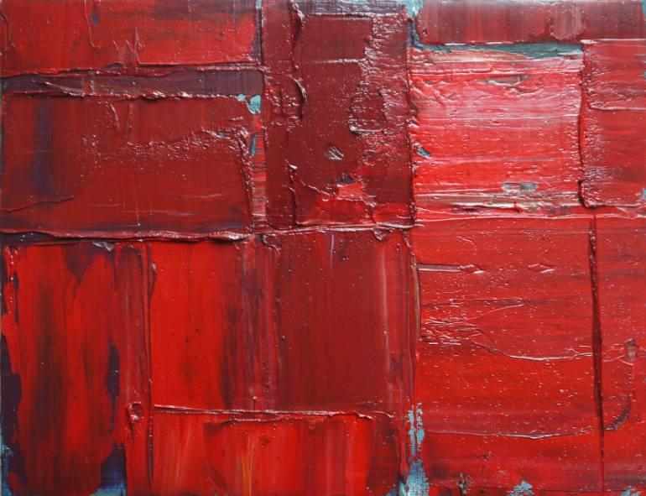
Niki Hare
Sr2
Oil, canvas, on wood
Colorfield Abstraction
Notes:
Beautiful use of blue to simulate light...does ayone know what I am looking at?
Just a note: Ms. Munoz and I discussed gestural abstraction (abstract expressionism) and decided to keep it off the list for this assignment.

