Slide 1
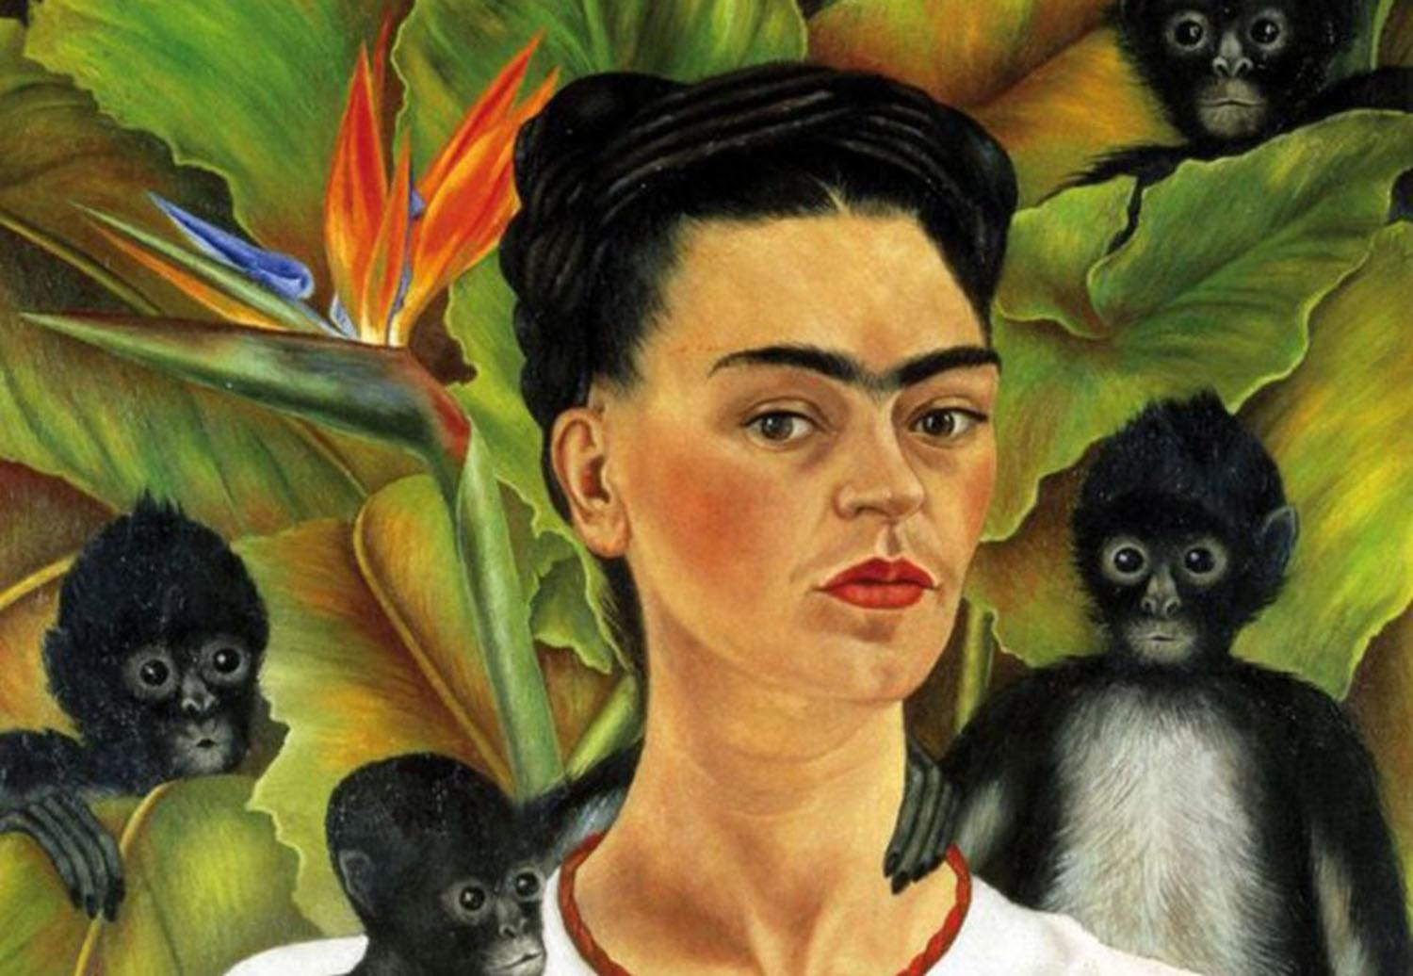

Slide 2
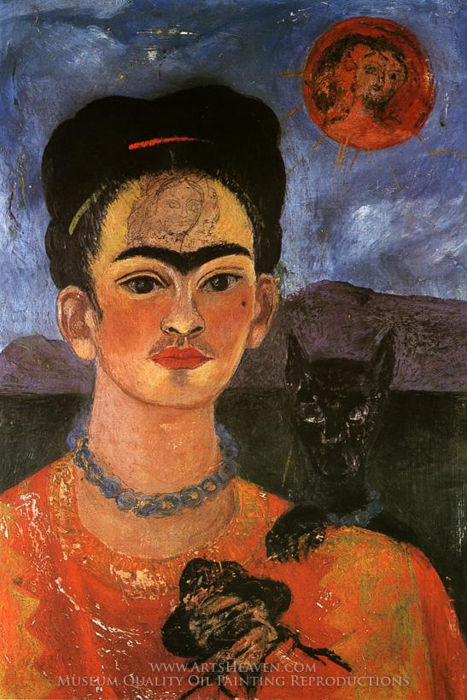
Self Portrait with a Portrait of Diego on the Breast and Maria Between the Eyebrows
1954
http://.fridakahlofans.com/c0660.html
Notes:
What is on her shoulder? What do you see in the moon? Does she look happy? What do you think the artist wanted us to feel?

Slide 3
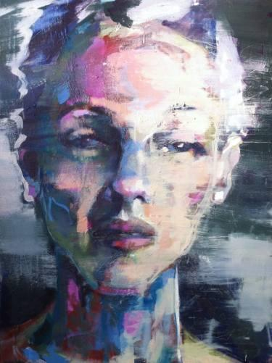
portrait girl 3
Birgitta Bachmann Sweden
Notes:
look at the way this portrait looks sad, how do the marks add to that? what else could her story by saying?

Slide 4
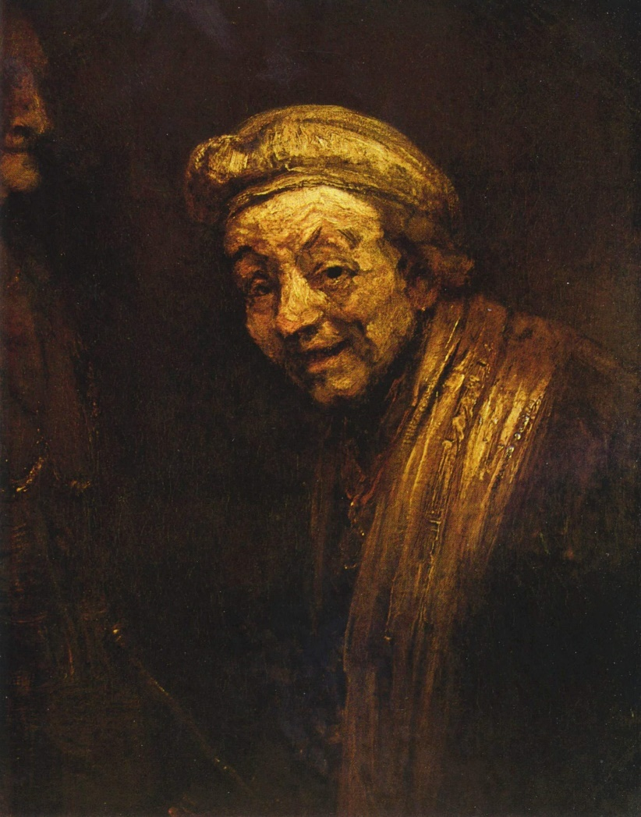
Self-Portrait as Zeuxis, c. 1662. One of 2 painted self-portraits in which Rembrandt is turned to the left, Wallraf-Richartz Museum, Cologne
Notes:
The effects of Rembrandt's visual aging may also be apparent in his self-portrait painted in 1669 (right), painted in the last year of his life. The detail is minimal, the artist's strokes are very broad, and the painting has a strong yellow cast, effects that are consistent with deteriorating vision. One of 2 portraits where he is turned left

Slide 5
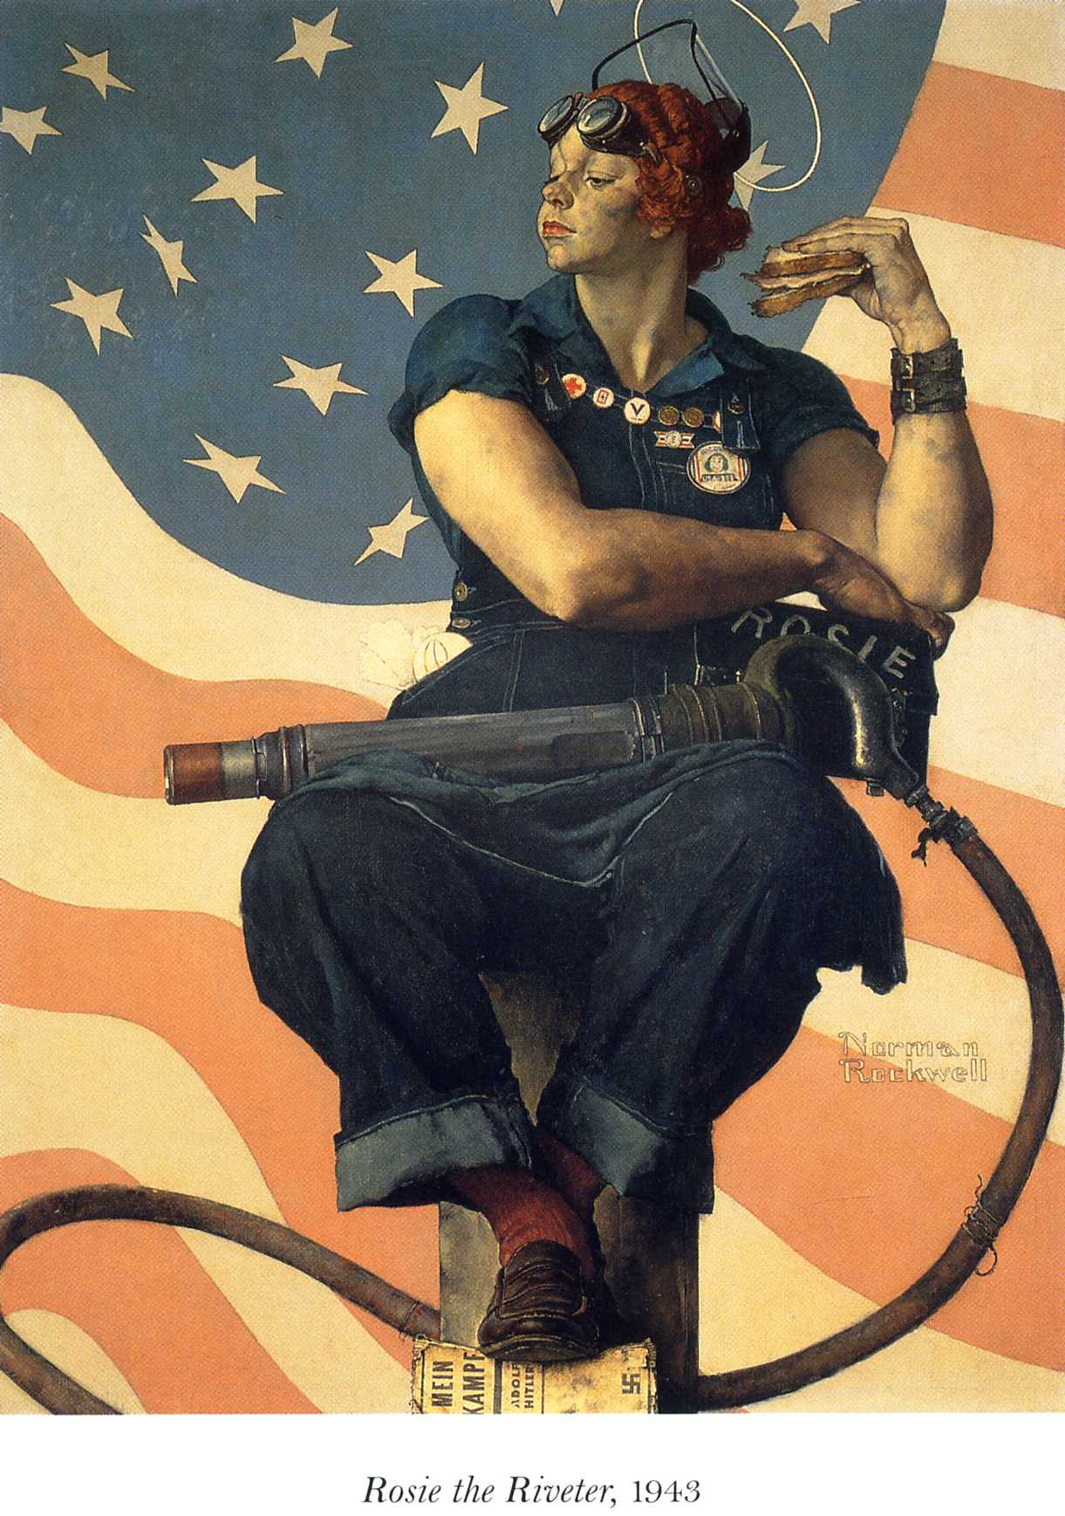
Norman Rockwell,
Rosie the Riveter, 1943
Crystal Bridges Museum of American Art
Notes:
Can anyone guess what she is? Why does she have a sandwich? Why do you think the artis, Norman Rockwell, put her up on a big post?

