Slide 1
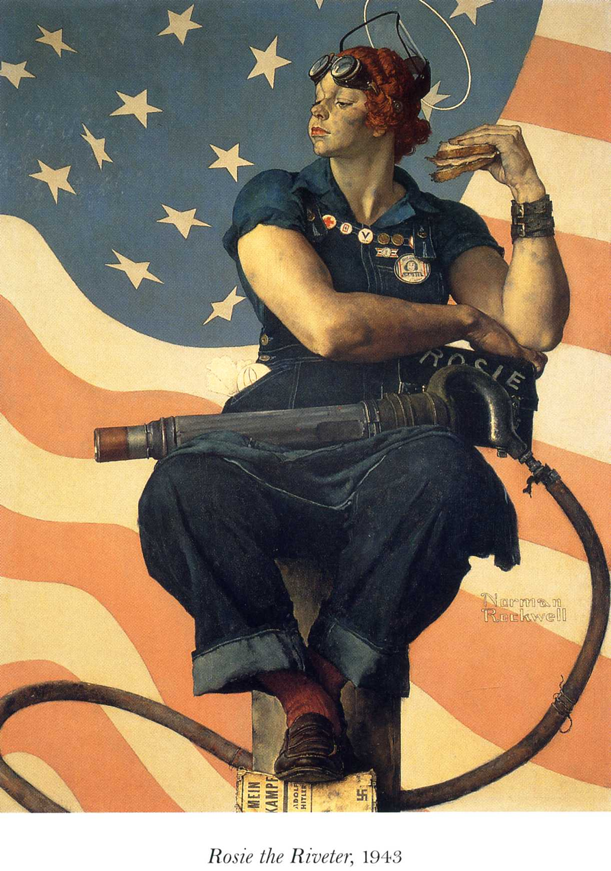

Slide 2
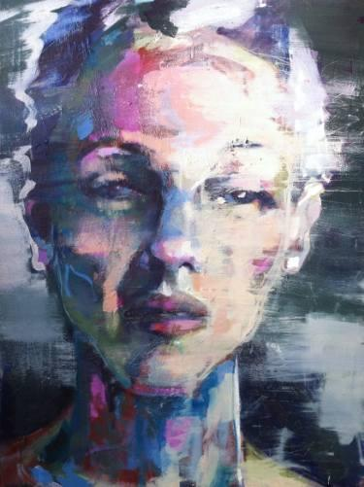
portrait girl 3
Birgitta Bachmann Sweden
Notes:
look at the way this portrait looks sad, how do the marks add to that? what else could her story by saying?

Slide 3
Notes:
The effects of Rembrandt's visual aging may also be apparent in his self-portrait painted in 1669 (right), painted in the last year of his life. The detail is minimal, the artist's strokes are very broad, and the painting has a strong yellow cast, effects that are consistent with deteriorating vision. One of 2 portraits where he is turned left

Slide 4
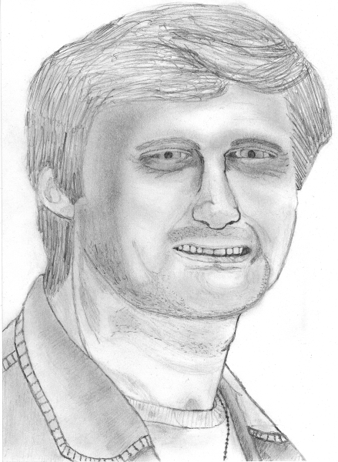

Slide 5
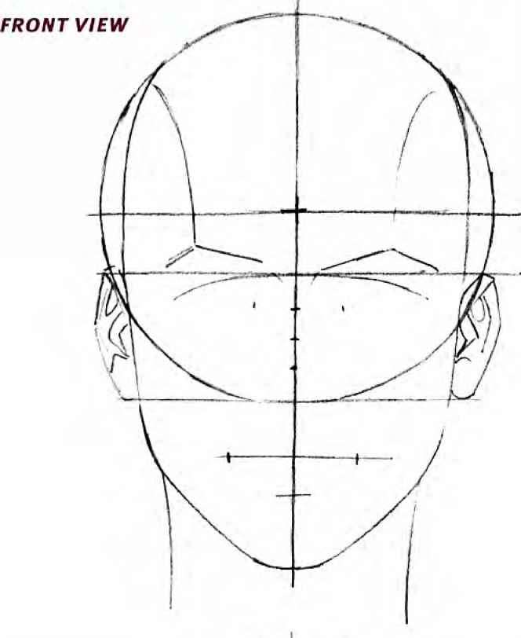

Slide 6
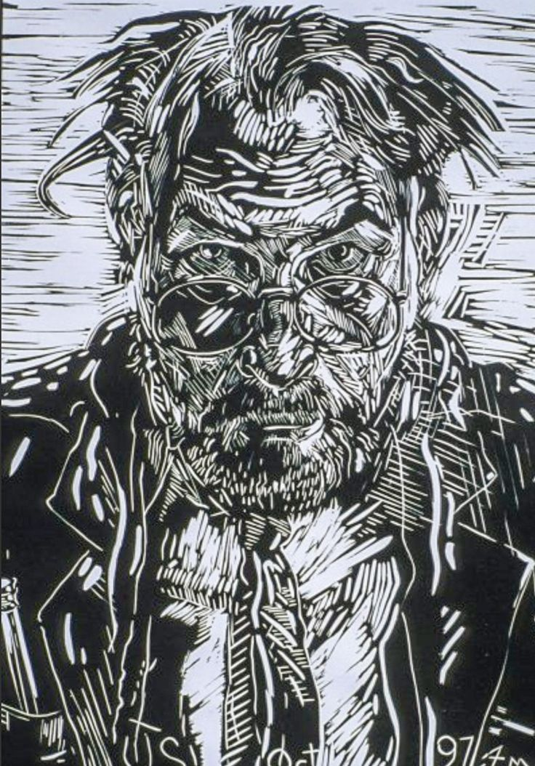
Notes:
this man looks rough, can anyone talk about the marks? how do they tell teh story?
we want you to explore your expressive side, use marks to add to your story. What is this portrait saying

Slide 7
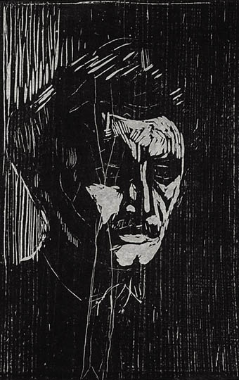
Notes:
here’s one with lines and black areas. How did the artist use the mark here? do you thing the long up and down could be important? where do you thing the ink was on the block?

Slide 8
Vocabulary
Linocut: Print made by transferring an image onto Linoleum, carving it out, and printing.
Gestalt: “An organizred whole that is perceived as more than the sum of its parts.” (google dictionary) The mind will finish objects if enough but not all information is provided.
Brayer: Roller used in printmaking to roll over ink to spread out a layer for printing.
Gouge: Tool used to carve linoleum, typically comes in “V” “U” and “Square” shapes.
Bench Hook: Tray that holds onto the edge of the table for stability and used as a base for carving. Important for safety and accuracy.

Slide 9
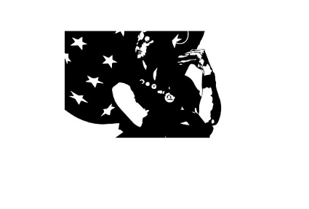
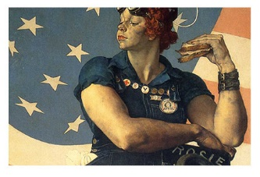

Slide 10
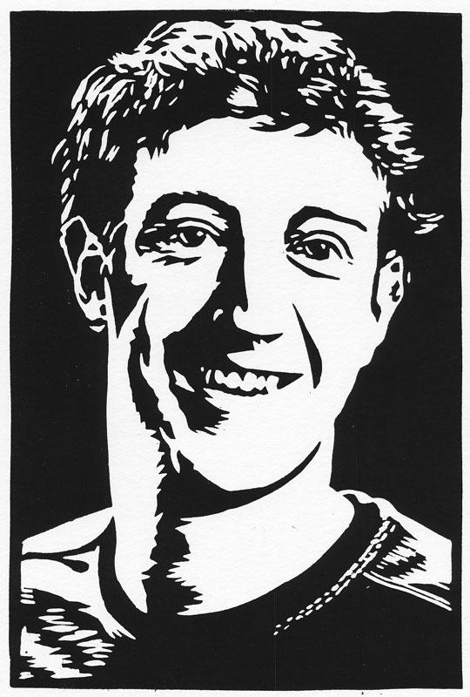

Slide 11
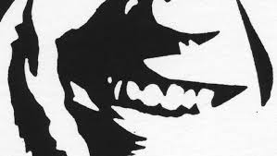

Slide 12
