Slide 1
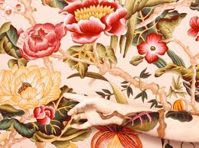
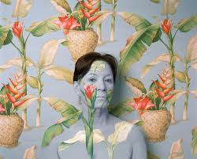
Figurative Abstract Portraits
http://www.artnet.com/artists/cecilia-paredes/

Slide 3
https://www.sfmoma.org/watch/ellsworth-kelly-explains-abstraction/

Slide 4
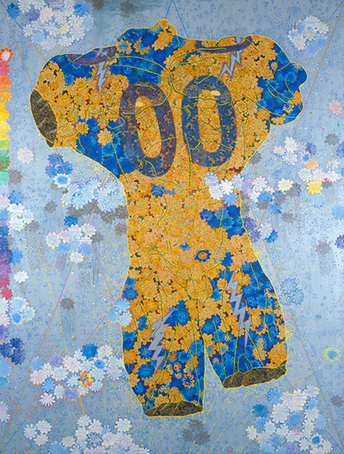
Figurative Abstraction
The Nature of How We See, Chie Fueki, 2005
Feminine and masculine roles, sexism, domesticity, textile art

Slide 5
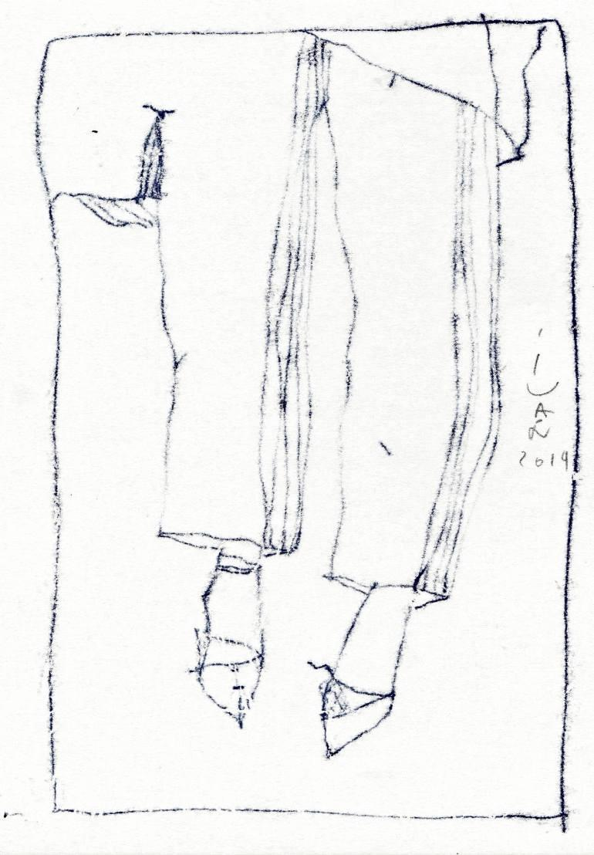
Ivan Pchelintsev
Ivan Pchelintsev
New Shoes
Figurtive Abstraction

Slide 6
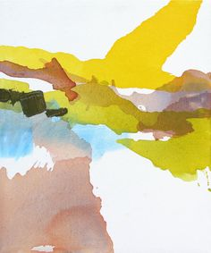
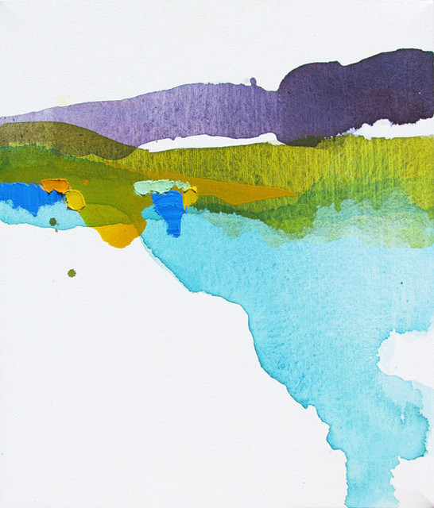
Lauren Adams, recent work
Landscape Abstraction

Slide 7
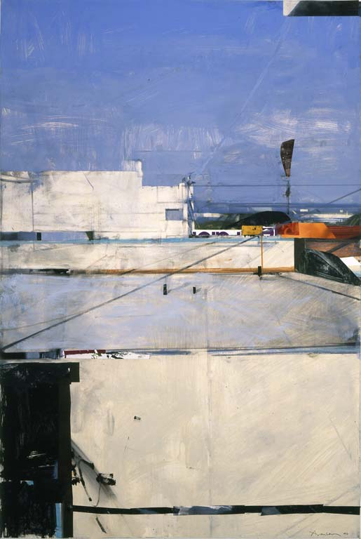
Santa Monica Rooftops, Ben AronsonssA
Landscape Abstraction

Slide 8
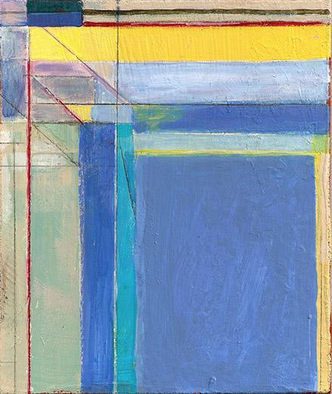
Ocean Park Series Richard Diebenkorn
Landscape Abstraction

Slide 9
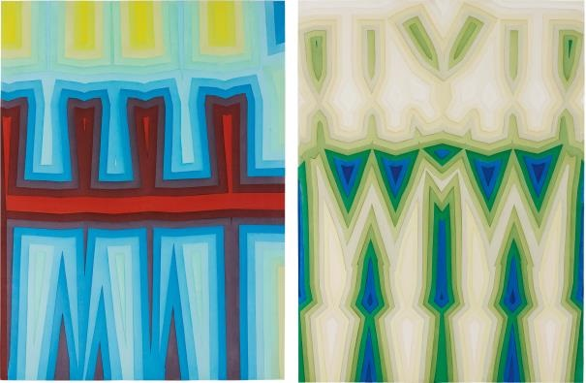
Tauba Auerbach
Two Works: (i) Fold / Slice Topo I;
(ii) Fold /..., 2011 113 x 188.2 cm.
Geometric
Abstraction

Slide 10
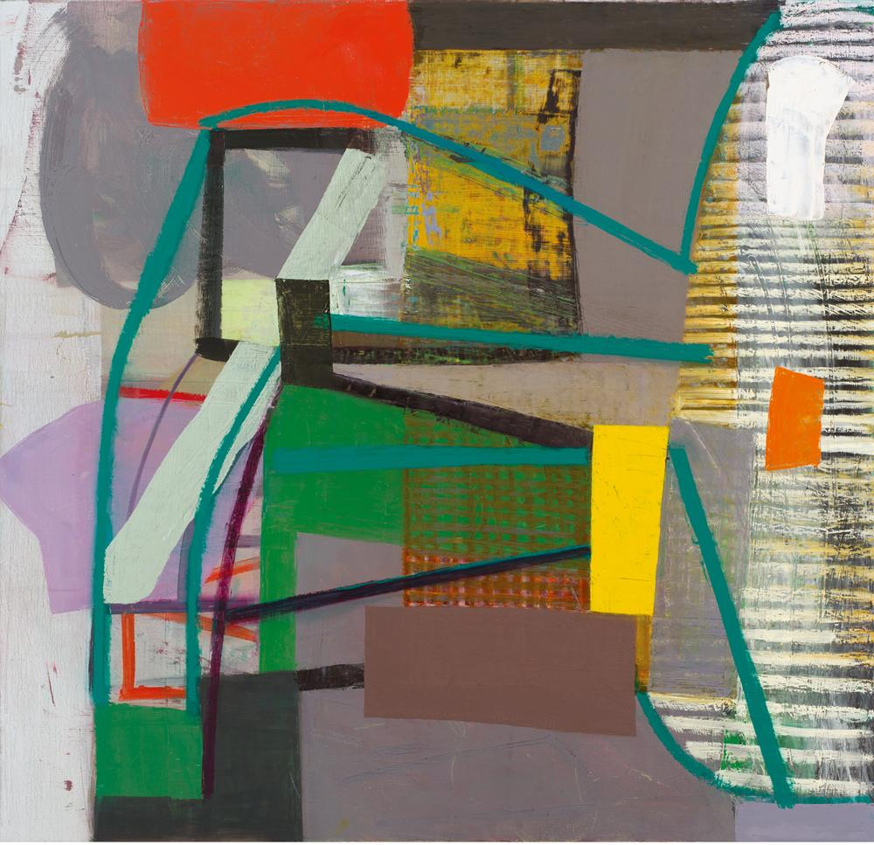
Amy Sillman, Untitled, 2013
Geometric Abstraction

Slide 11
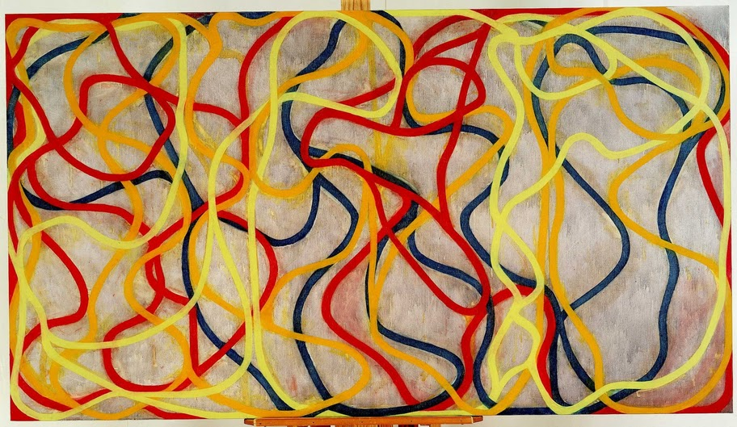
Brice Marden
Chinese Dancing, 1994-96. Oil on canvas, 60 x 108.
Calligigraphic Abstraction

Slide 12
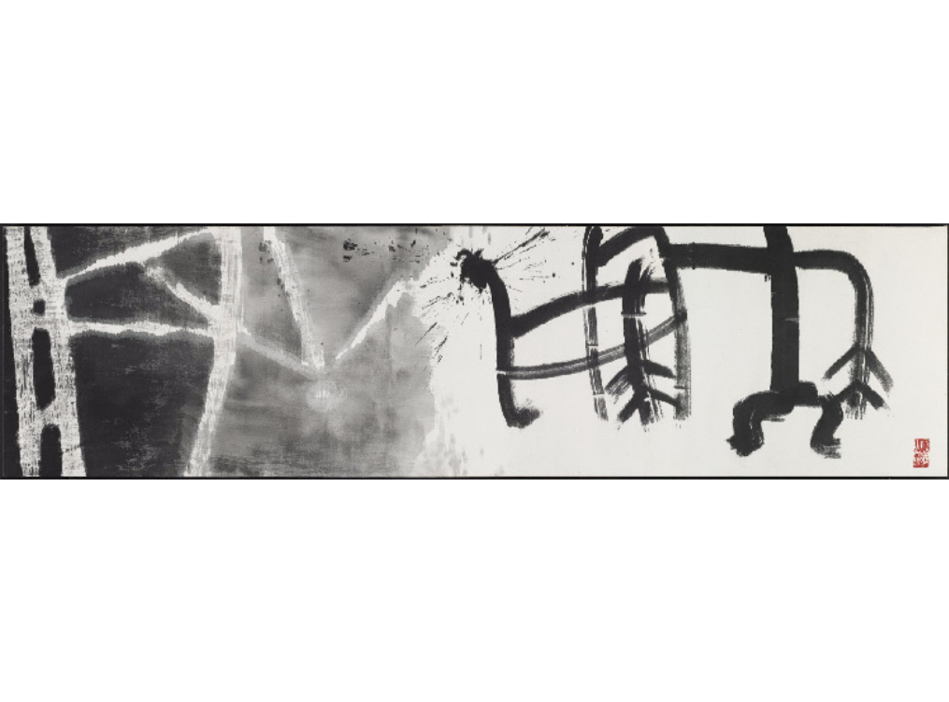
Caligraphic Abstraction
Son Man-jine
Use of the Useless (Quotation From Zhuangzi ca. 300 B.C.), 1999 Ink on cloth 31 1/2 × 110 1/5 in 80 × 280 cm

Slide 13
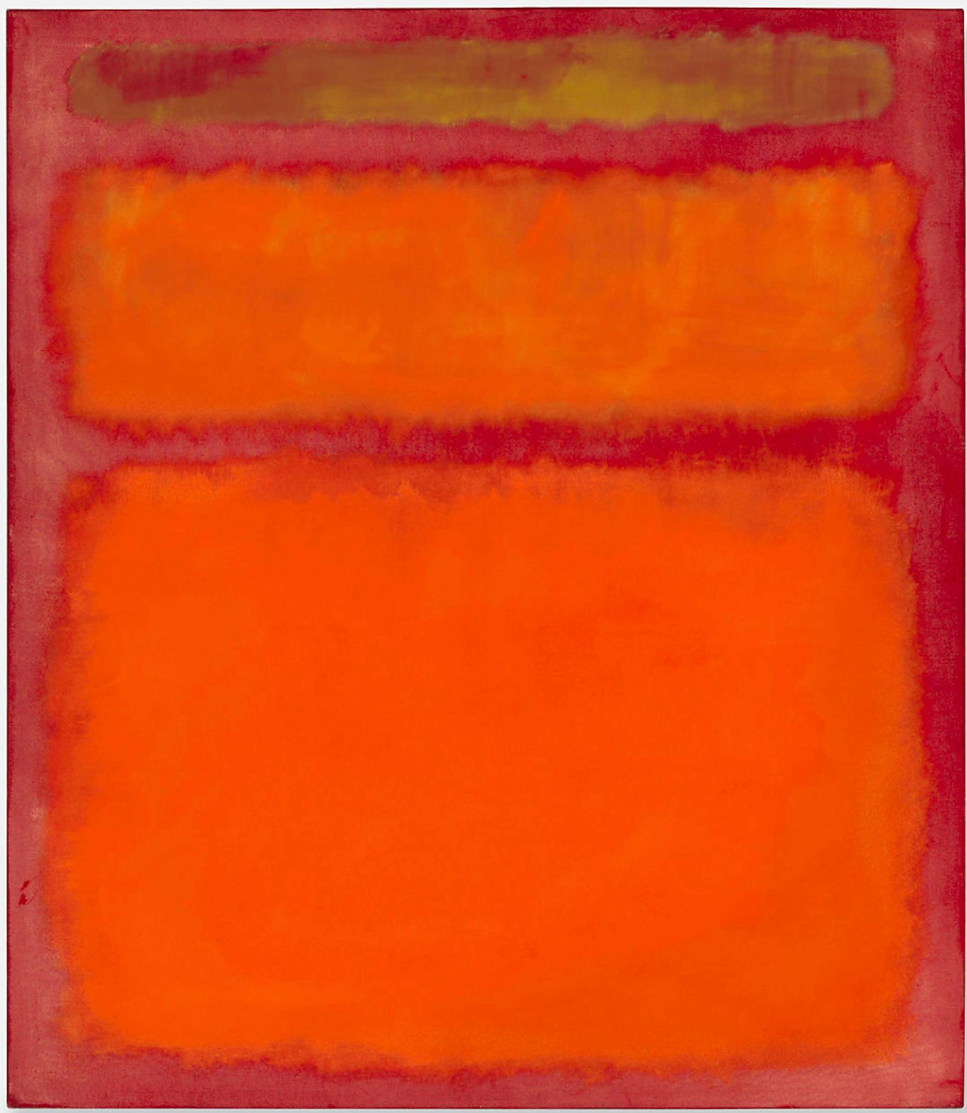
Mark Rothko
Orange, Red, and Yellow, 1961
Colorfield Abstraction

Slide 14
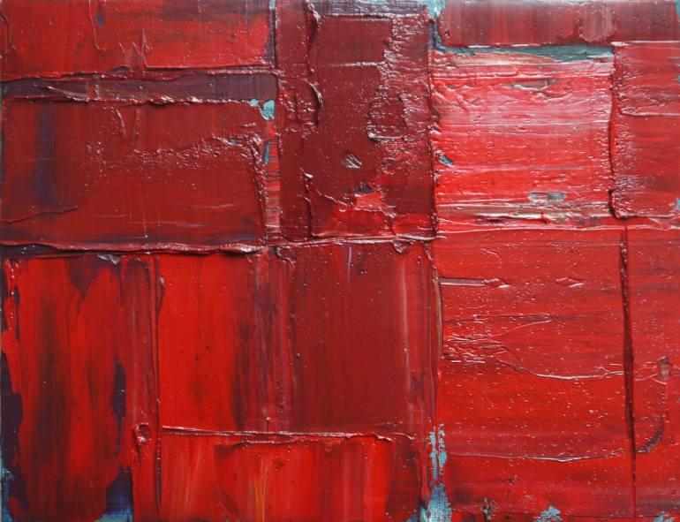
Niki Hare
Sr2
Oil, canvas, on wood
Colorfield Abstraction

Slide 16
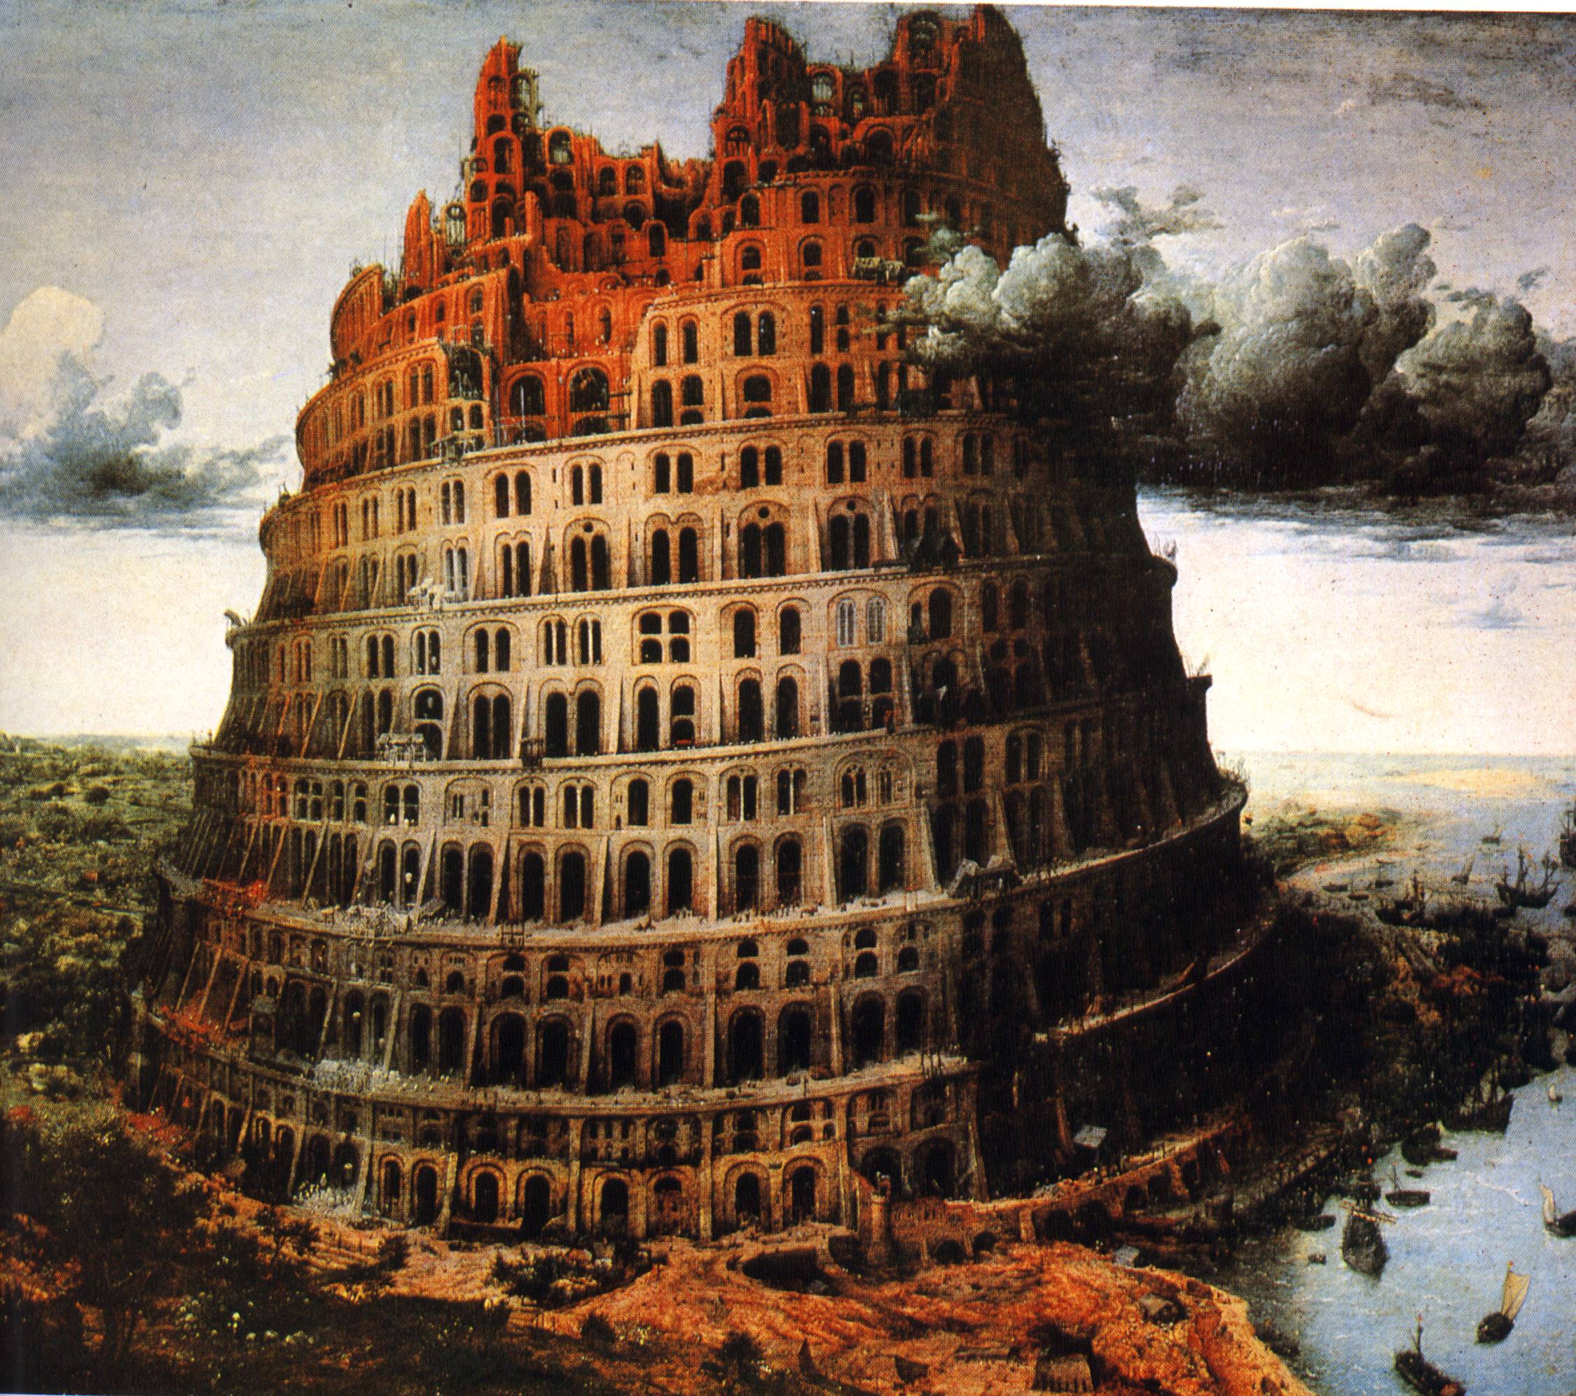
Tower of Babel, Breugel, 1563

Slide 17
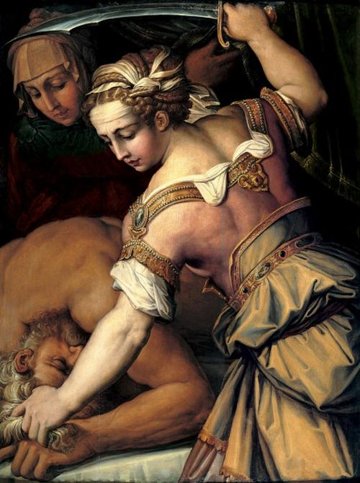
Judith slaying Holofernes by Artemisia Gentileschi, 1614–18

Slide 18
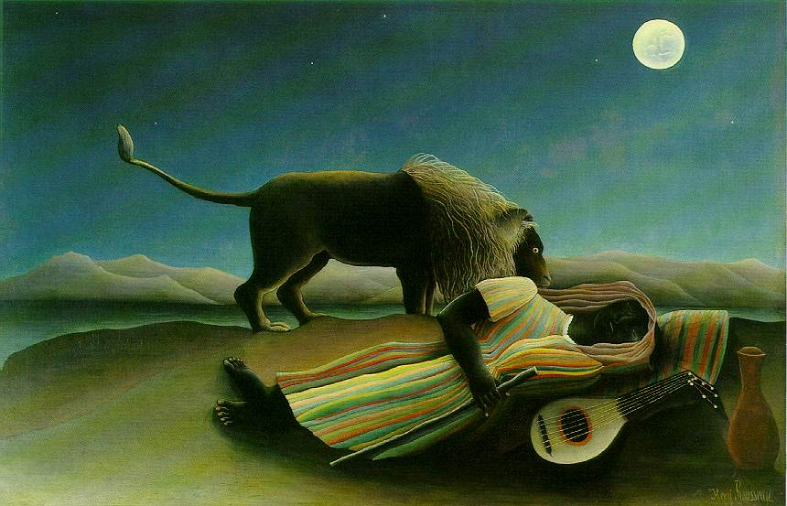
Roussea, Sleeping Gypsy, 1897

Slide 19
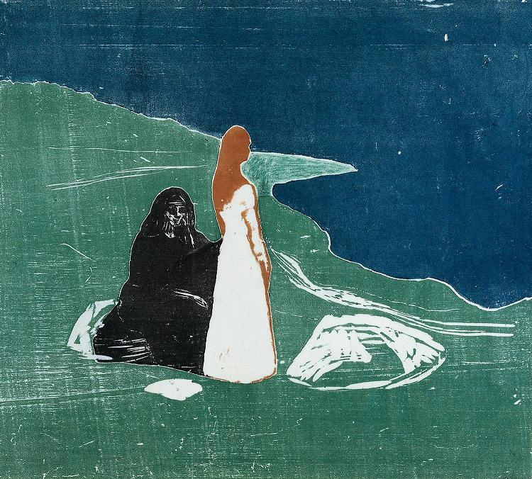
Woman on the Beach, Edvard Munch, 1906

Slide 20
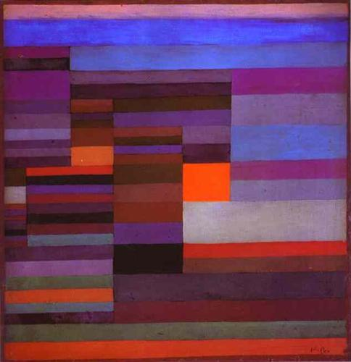
Fire Evening, Paul Klee, 1929

Slide 21
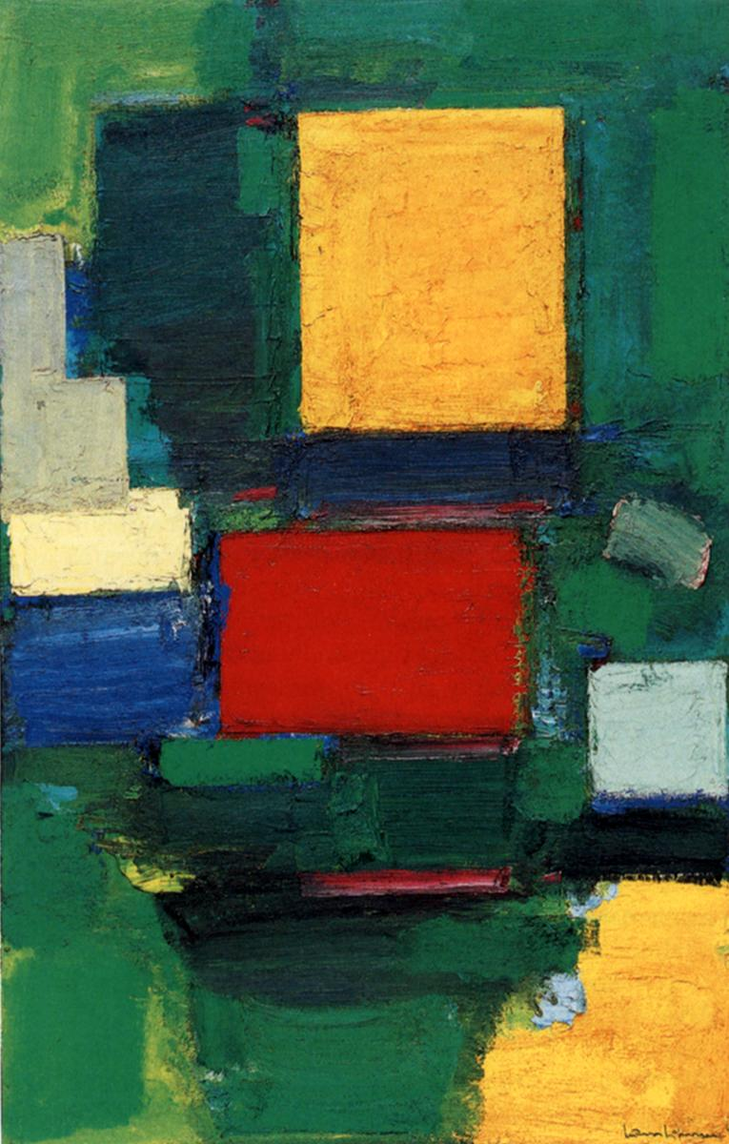
The Gate by Hans Hoffman, 1960

Slide 22
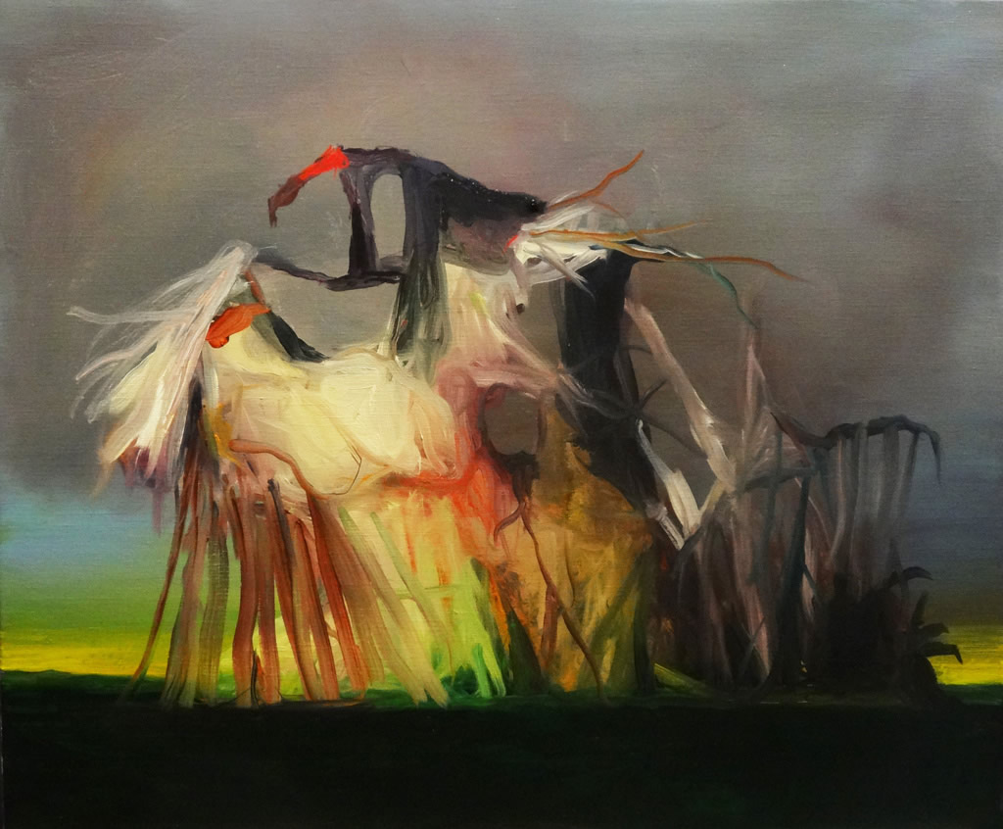
Sin título. 2015. Óleo sobre lienzo. 55 x 46 cm
Joseba Eskubi

